Slide 1
MedImaging Overview
Dimple Khatri¹ & Dr. Sanjan TP Gupta^{2,3}
¹ – University of Maryland Baltimore, USA; ² – Indian Institute of Technology (IIT-Madras), India, ³ – University of California Santa Barbara, USA
Correspondence: sanjan.tp@biotech.iitm.ac.in
Dec 2025

Slide 2
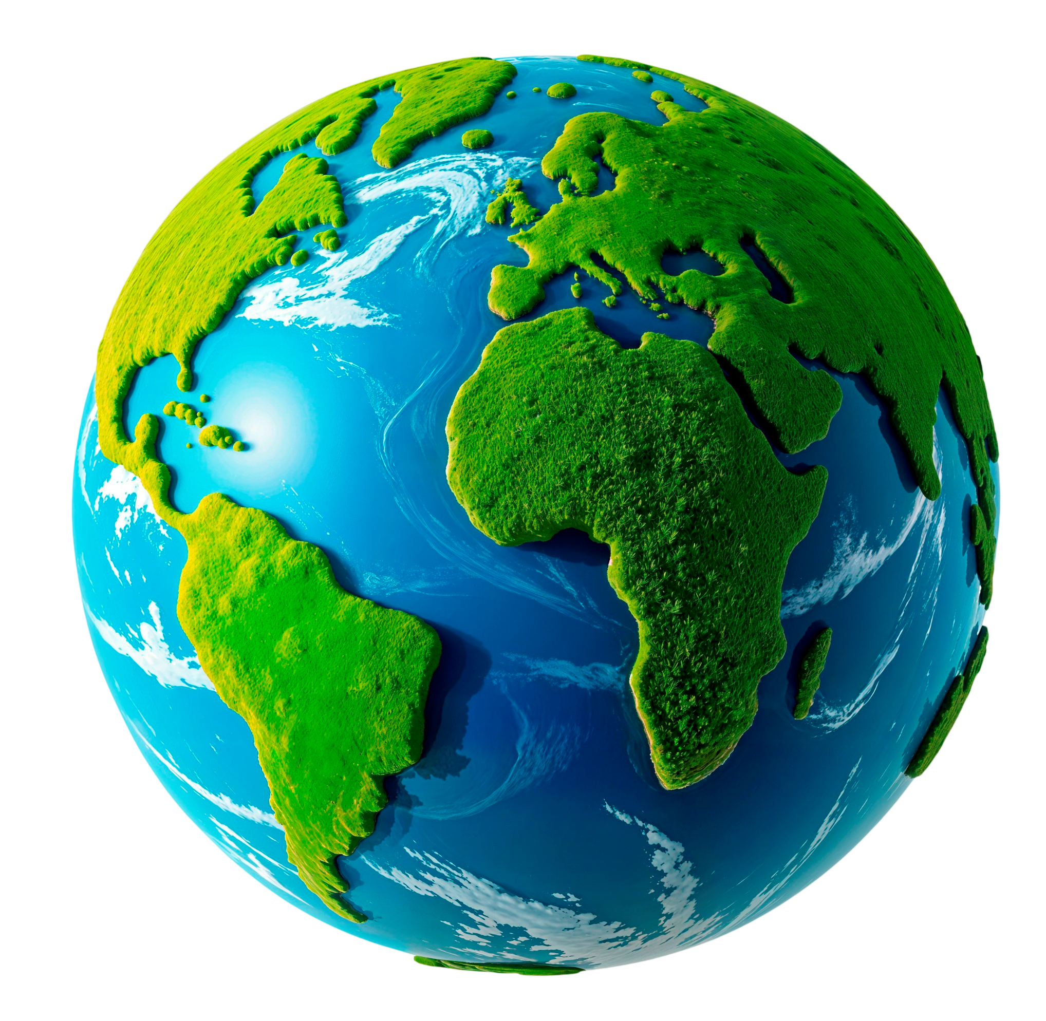

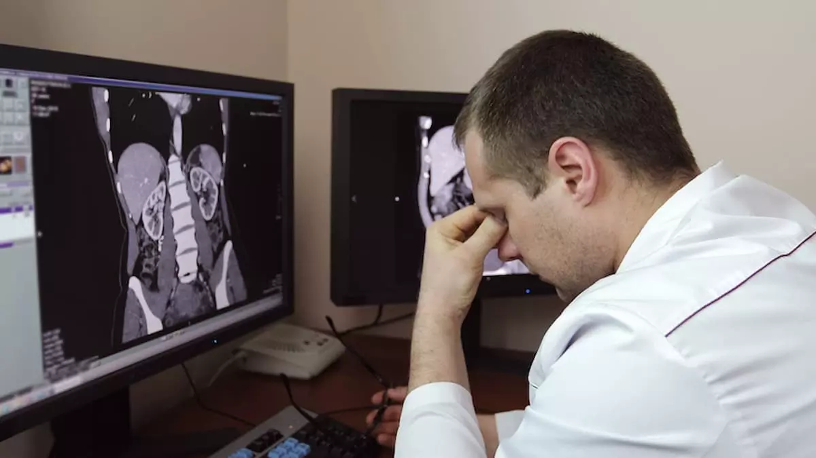




Motivation
Just 1 radiologist for 100 scans a day ➔ visual and cognitive fatigue
Not just LMIC but developed nations like UK, Japan & Singapore also have a shortage of radiologists
Only 1 radiologist for every 1 lakh patients in India

Slide 3
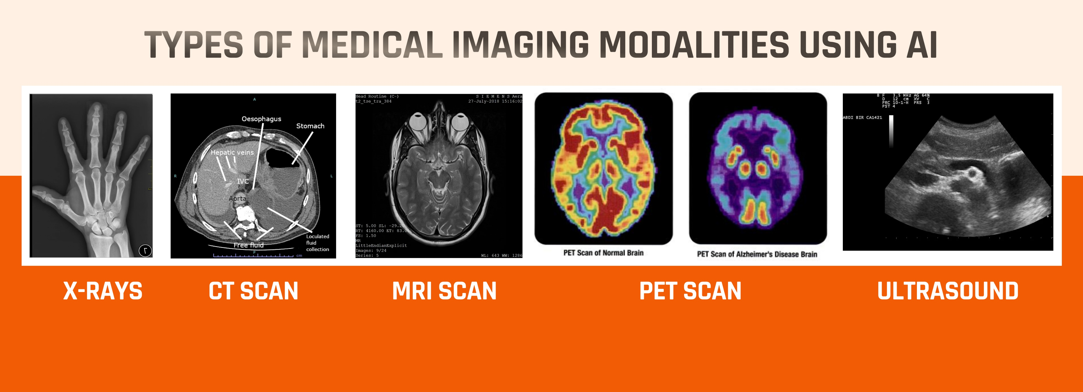
https://www.digitalhealthnews.com/from-pixels-to-precision-ai-s-game-changing-role-in-medical-imaging

Slide 4
Evolution of medical imaging diagnostics
0th Generation: Manual Examination by Radiology Experts
1st Generation: Computer assisted enhancement to aid radiologists
Noise reduction of low-light medical images
Image segmentation to outline body parts and disease-affected areas
Value Addition: Enhanced diagnostic accuracy & minimize the need for re-examination
Jio Institute’s Computer Vision Medical Imaging group
2nd Generation: AI-driven pattern recognition to aid radiologists
Identifying complex patterns indicative of specific diseases
Spotting lesions, detecting abnormalities, diagnosis (healthy vs TB)
Value Addition: Early detection and reduction of manual errors
Qure.AI
3rd Generation: Automated report generation using Generative AI to aid radiologists
Interpret X-rays, generate EHR-ready reports with clinical patient history, and cross-reference patients with similar diagnoses
Value Addition: Address the radiologist:patient shortage (speeding up diagnosis + cutting down administrative workload), Detection of comorbidities

Slide 5
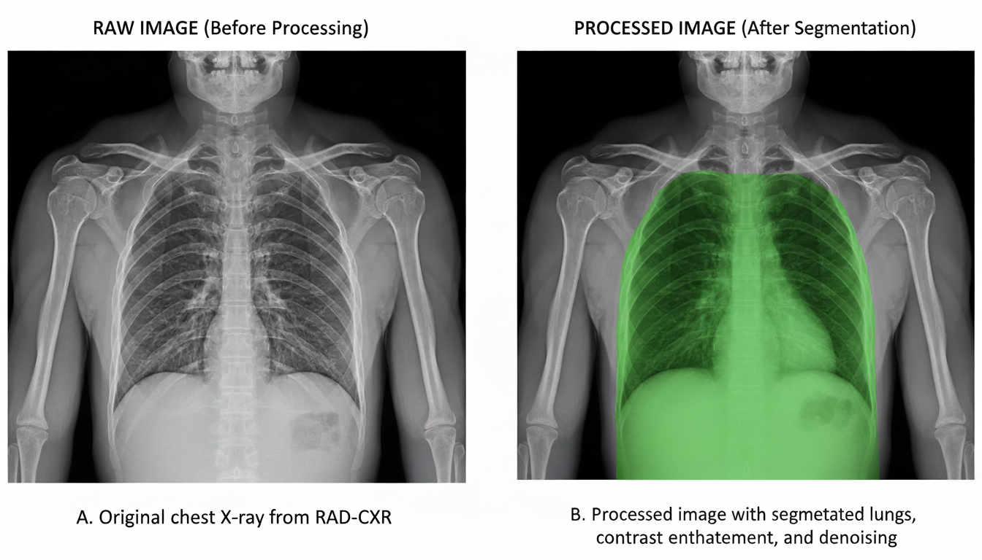
Medical Image Pre-processing workflow
Resizing
(224 x 224 pixels)
Denoising
(Gaussian Blur)
Contrast Enhancement
(CLAHE)
Image Segmentation (Canny Edge detection)

Slide 6
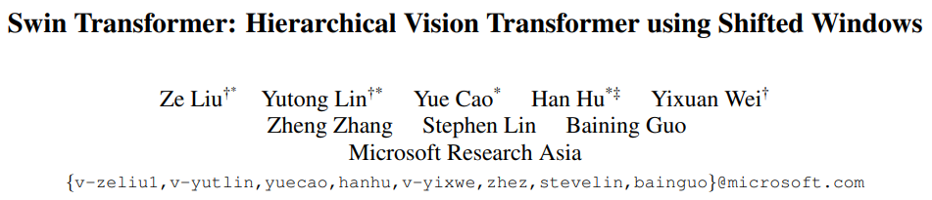
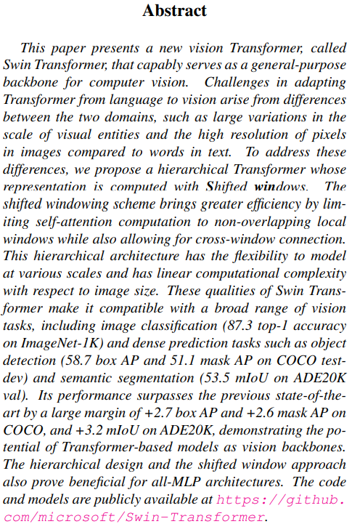
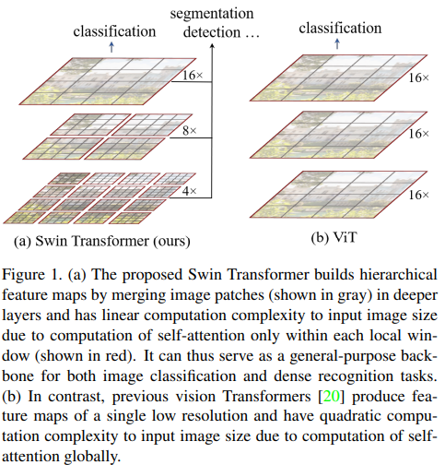

Slide 7
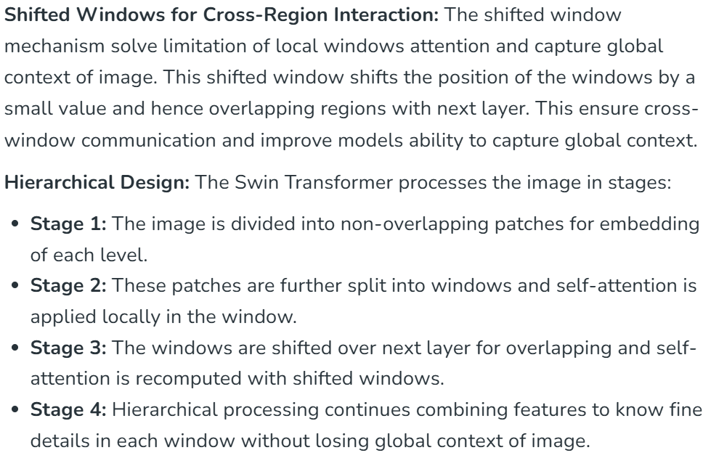
Source: https://www.geeksforgeeks.org/computer-vision/swin-transformer/

Slide 8
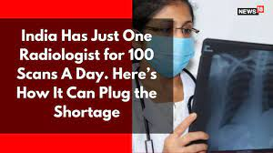
Need for automated diagnosis
Only 1 radiologist for every 1 lakh patients – substantially lower than global health standards
Uneven distribution – scantier in Tier-2 & Tier-3 cities and often none in rural areas
According to the data by WHO there is no radiologist at all in Africa – they primarily rely tele-radiology consultations
Shortage is not limited to developing countries alone but impacts developed nations too such as UK, Japan and Singapore
AI can interpret X-rays, generate EHR-ready reports with clinical patient history, and cross-reference patients with similar diagnoses
India’s diagnostic imaging device market - $7 Billion by 2033 with CAGR = 7% [As per GlobalData]
As of 2024, India has ~20% share in APAC diagnostic imaging market
https://medicalbuyer.co.in/india-has-alarming-ratio-of-one-radiologist-per-lakh-people/ [Oct 2023]
https://www.digitalhealthnews.com/indian-imaging-device-market-to-surpass-7-bn-by-2033 [GlobalData]

Slide 9
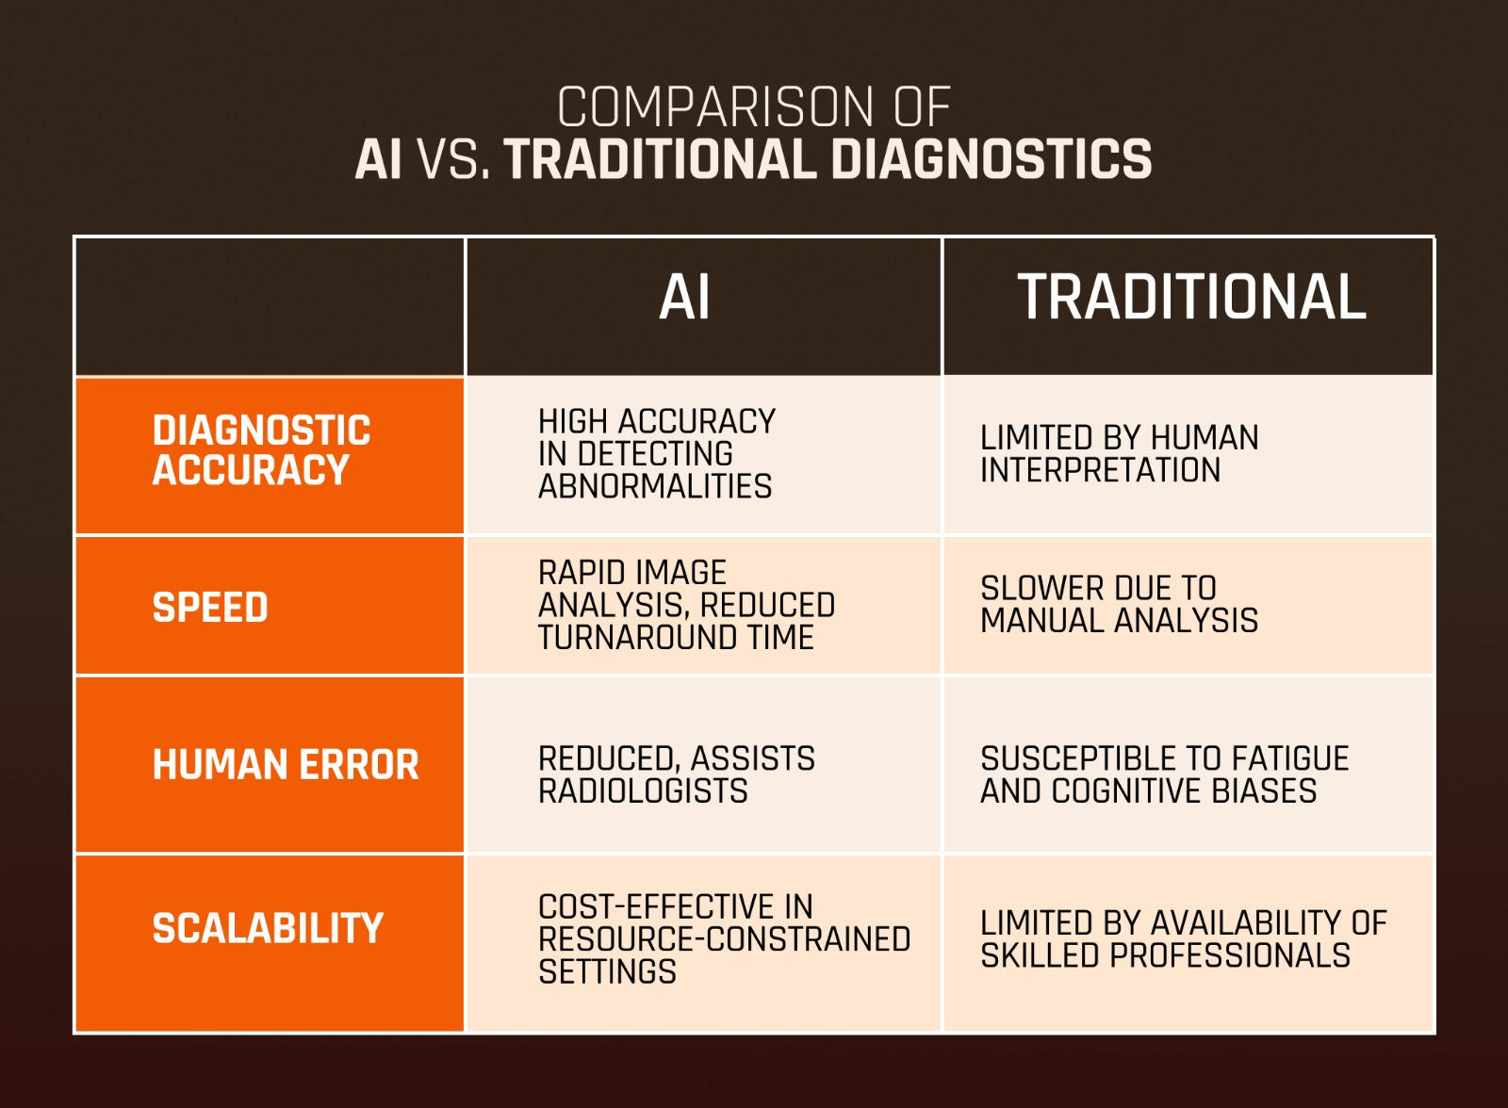

Slide 10
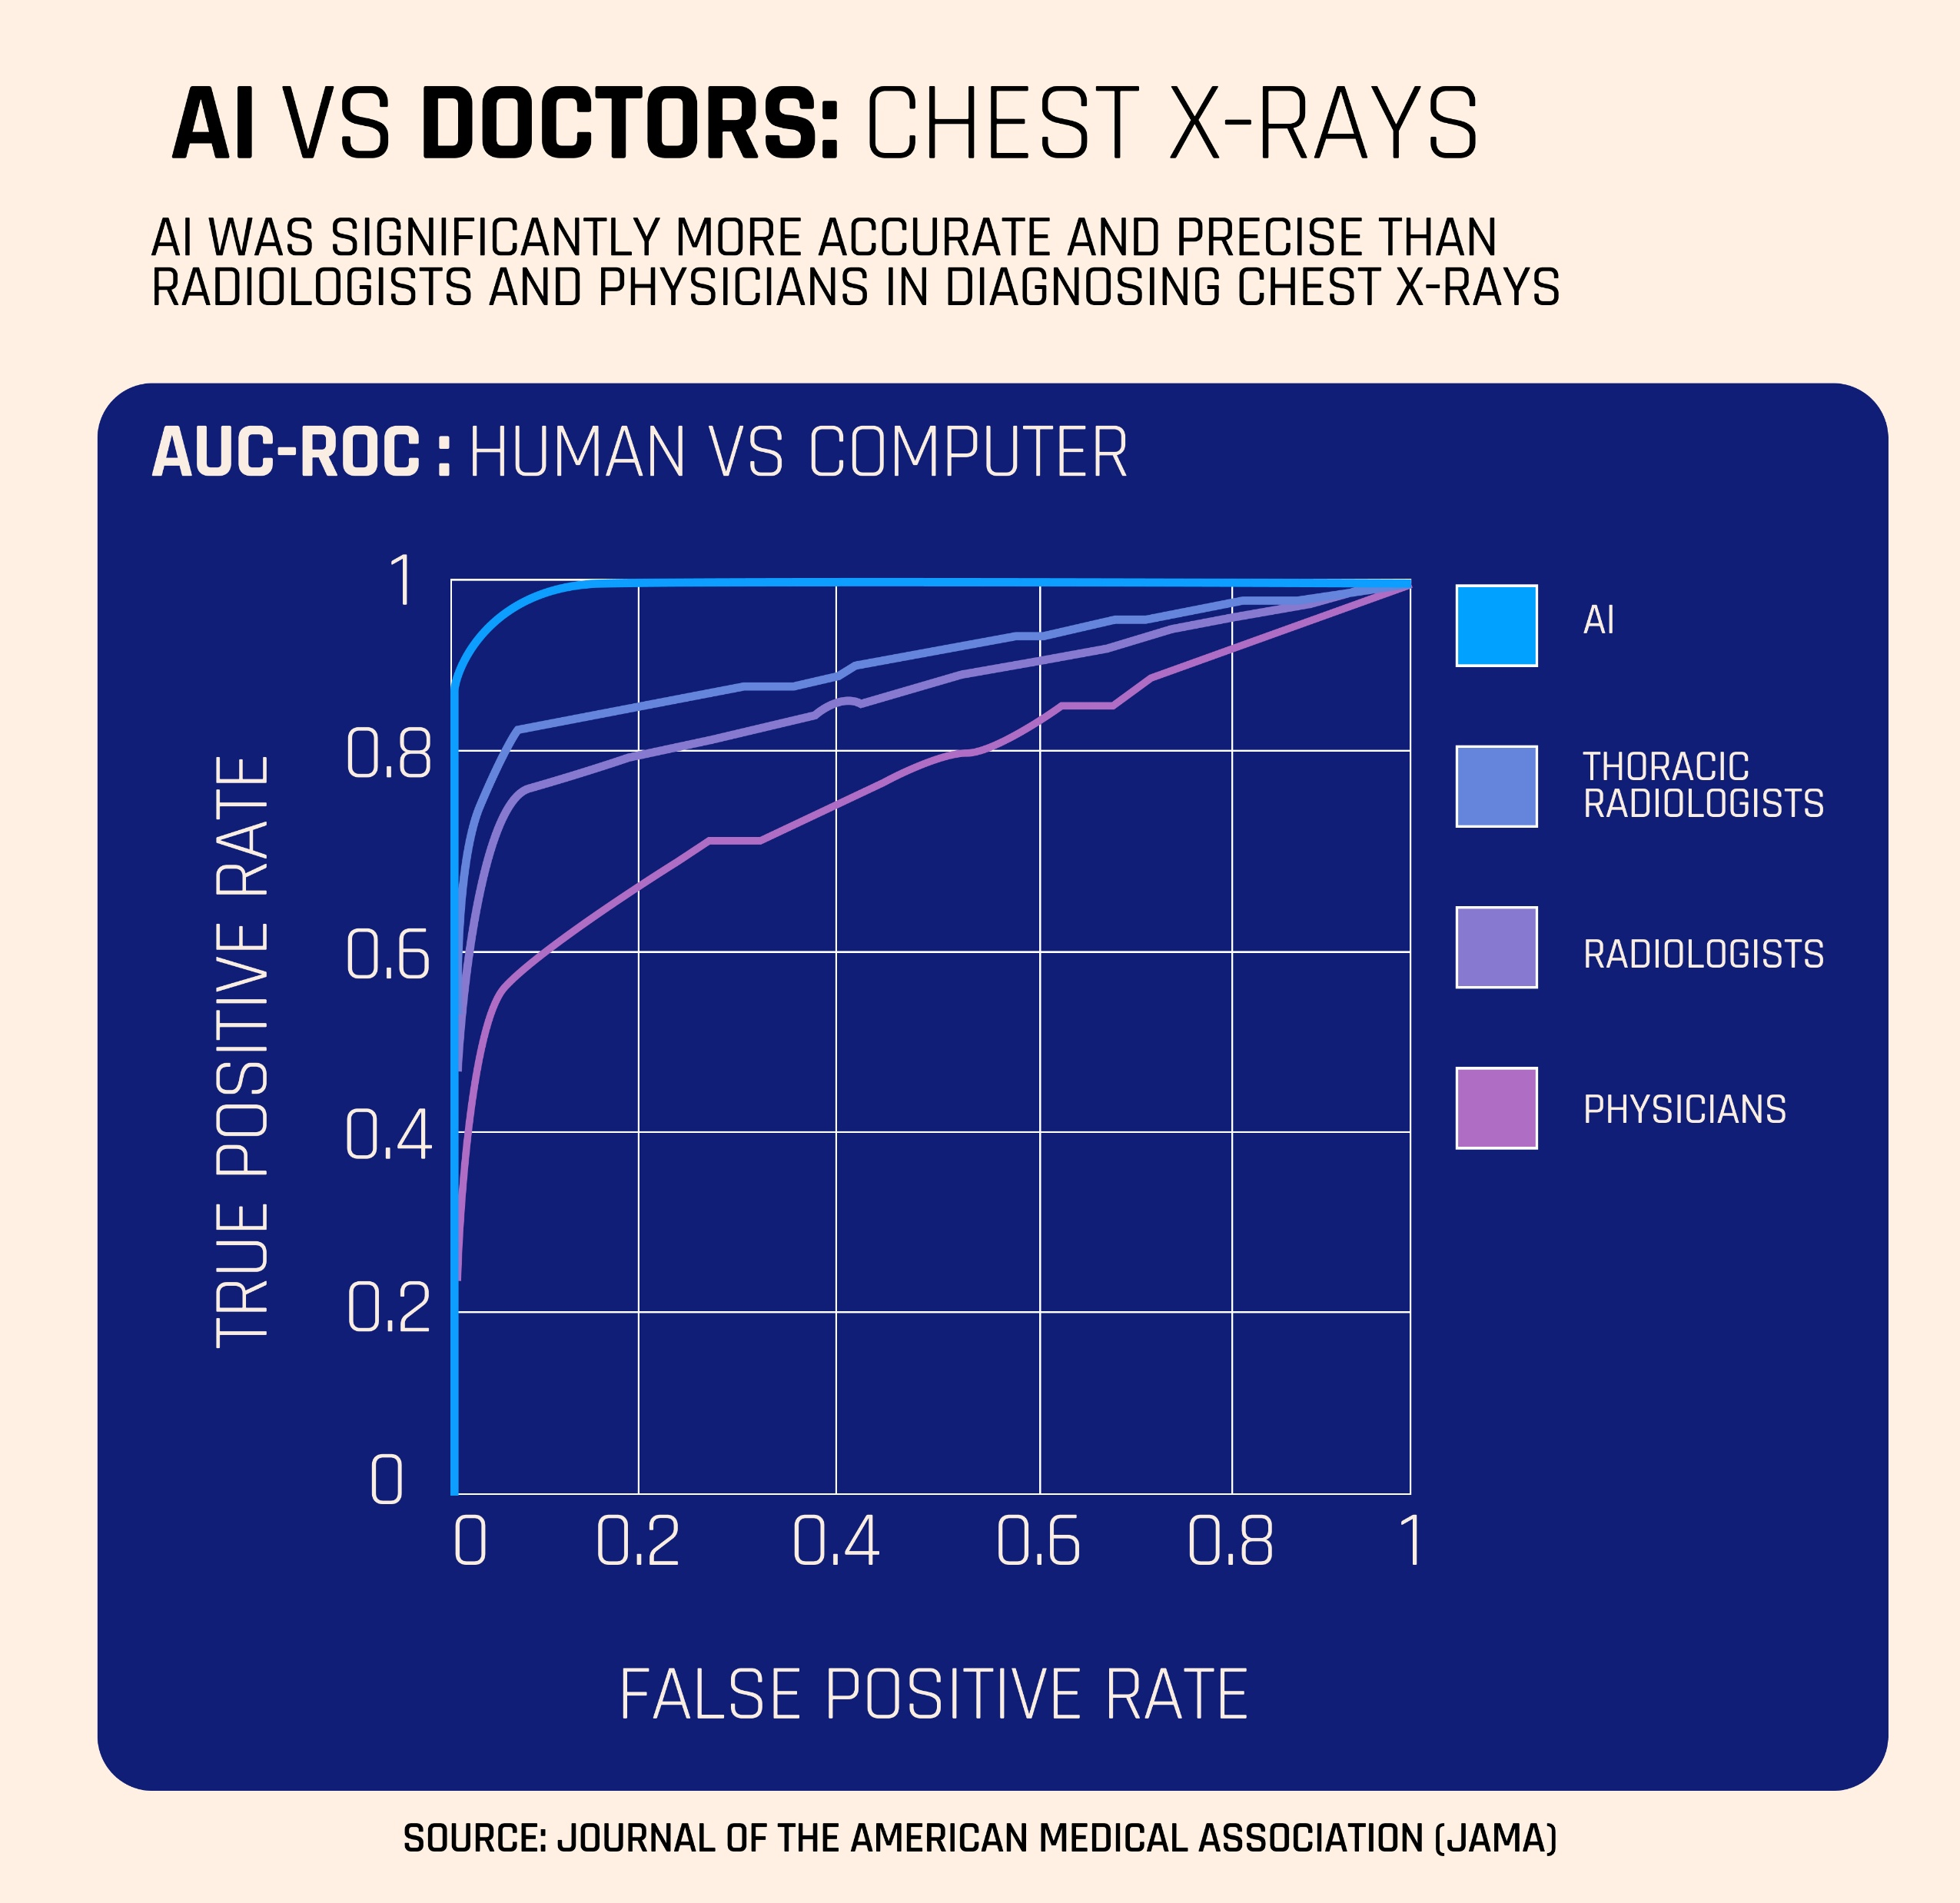
AI SOTA models

